Slide 1

Growth Force

Slide 2

Goal:
To increase user connection and engagement

Slide 3

You need to feel connected to the cause

Slide 4
“When I met Gabby for the first time at a check up appointment, I could have never imagined the impact she would have on my life, but five years and around a hundred memories later, having Gabby as my little sister continues to be something very special and important to me.”
Alexa, NYU about the B+ Heroes program

Slide 5
Our solution

Slide 6

Defining the user to build better relationships
Figuring out the demographics of our users to better personalize their experiences with B+
Currently using Salesforce, but not to full capacity
Large social media following, regular blog posts, but no analytics for defining performance

Slide 7

Easier analytics for personalized marketing
Tells who to target
Compare to current users
Maximize donations long-term
Using Machine Learning, we target a user based on where they are most likely to donate. Also, a feature identifying our most connected users.
Compare the data to Salesforce’s current data on B+.
Bridge the gap between the two data sets, targeting high potential users for eventual donations and more personalized connection with highly connected users.

Slide 8

89,526,124$
185,244 users
100%
That’s a lot of money
And a lot of users
Total success!
Notes:
Online resources are considered 20% more useful than direct mail when it comes to influencing donors.
57% of people who watch nonprofit videos go on to make a donation.

Slide 9

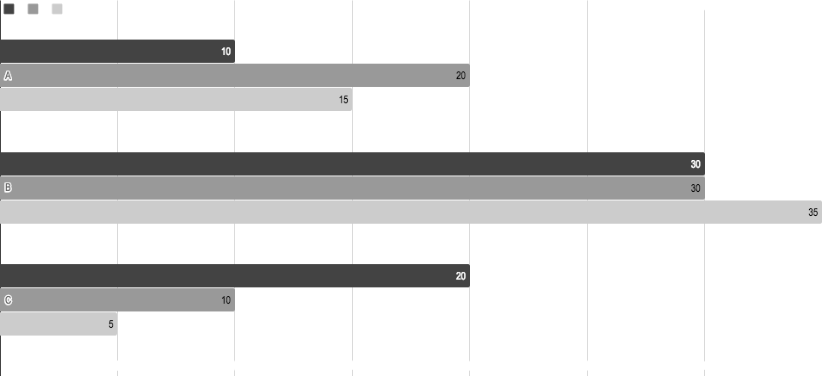
You can insert graphs from Google Sheets

Slide 10

THANK YOU!
Any questions?

